Slide 1


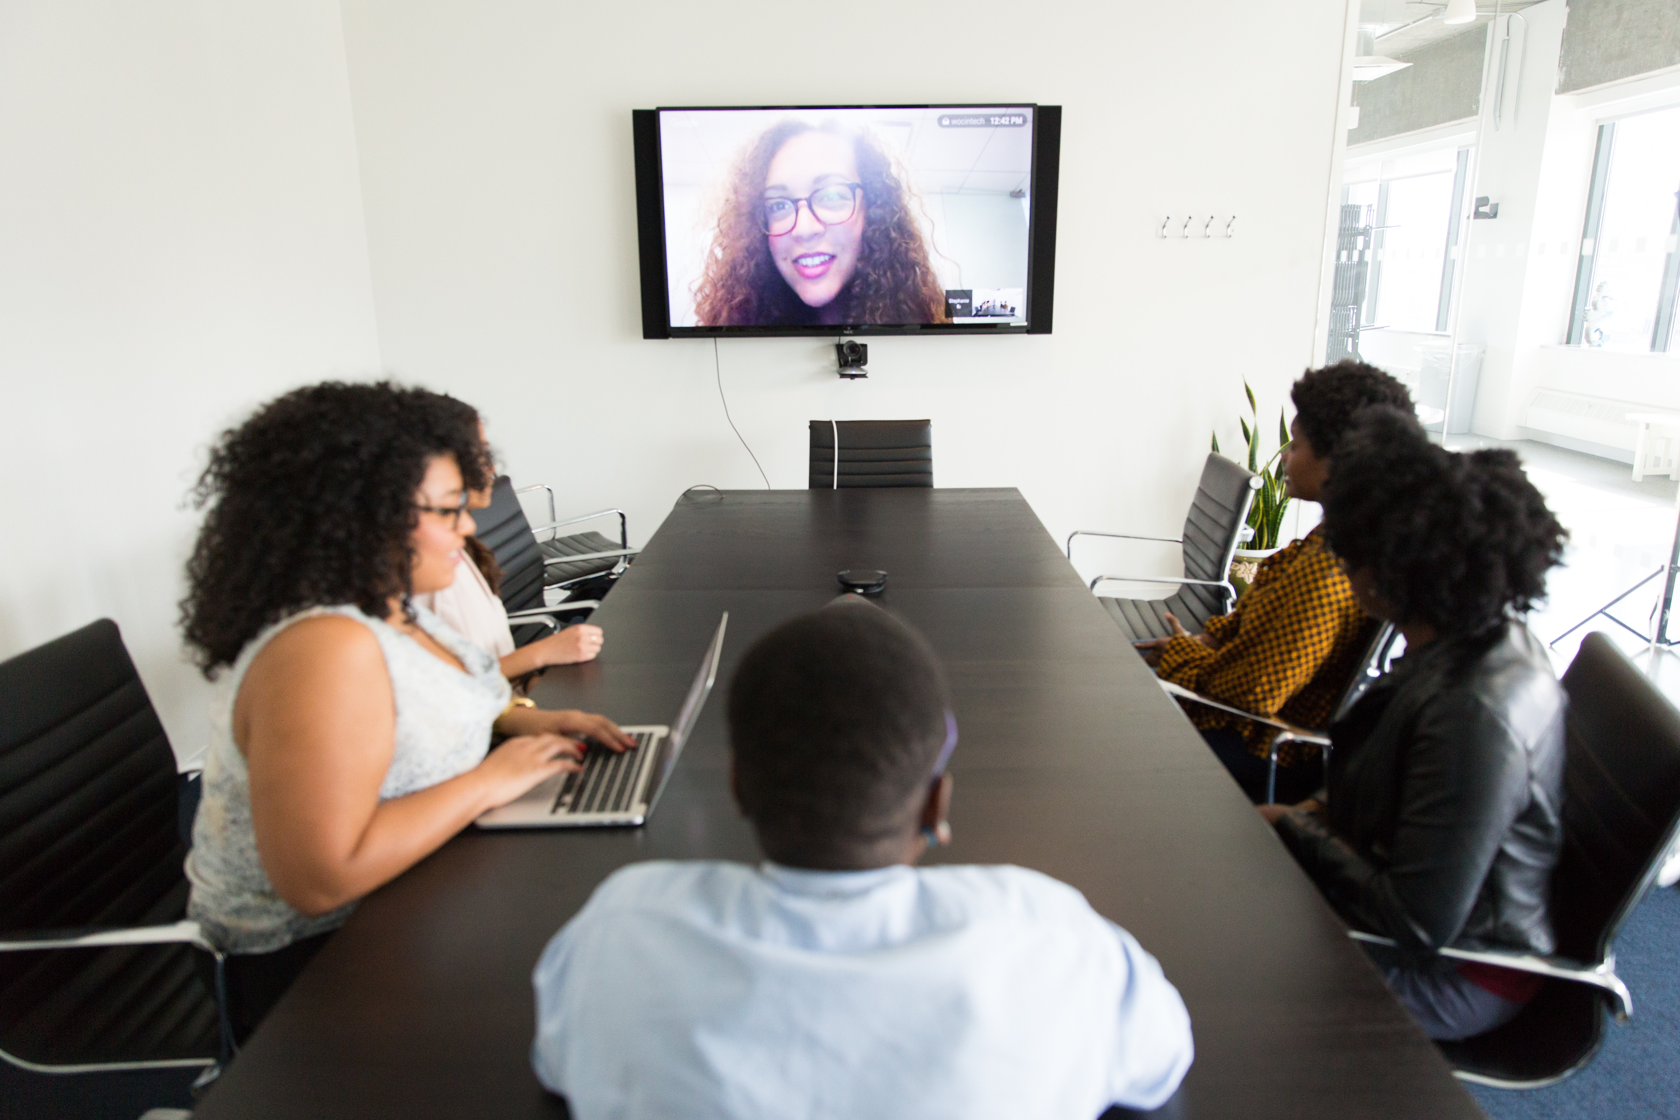

Future ways of working
- When online meeting meets problems -
Team：Uncle Winston. Company: Logitech.

Slide 2
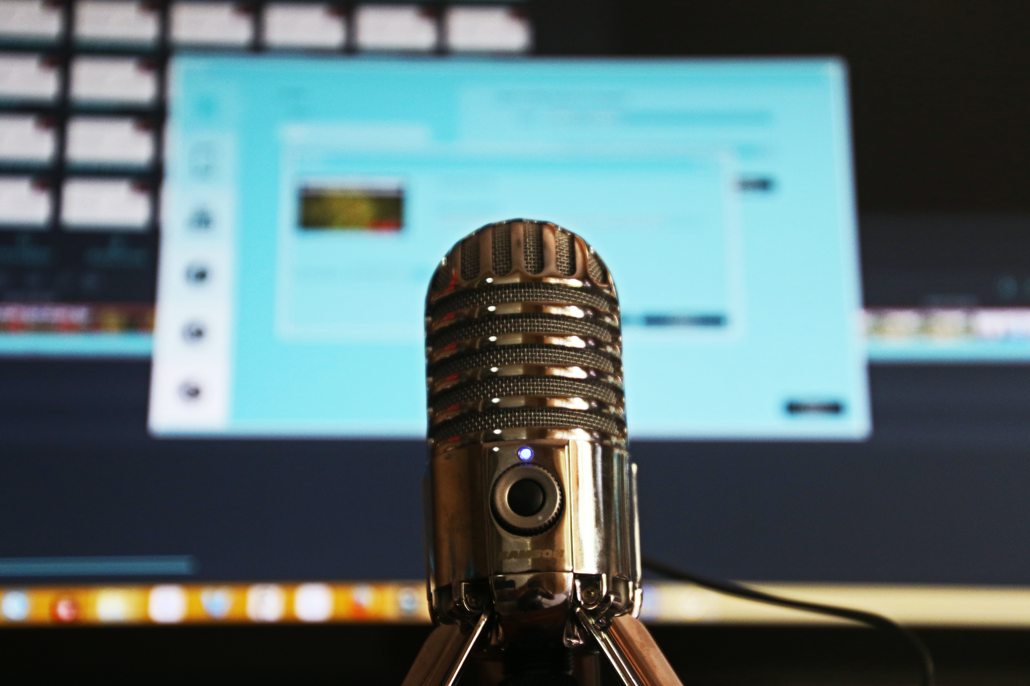



Problem 1 - mic
We thought that one of the most common issue is people usually find out they didnt turn on their mic after speaking a lot.

Slide 3
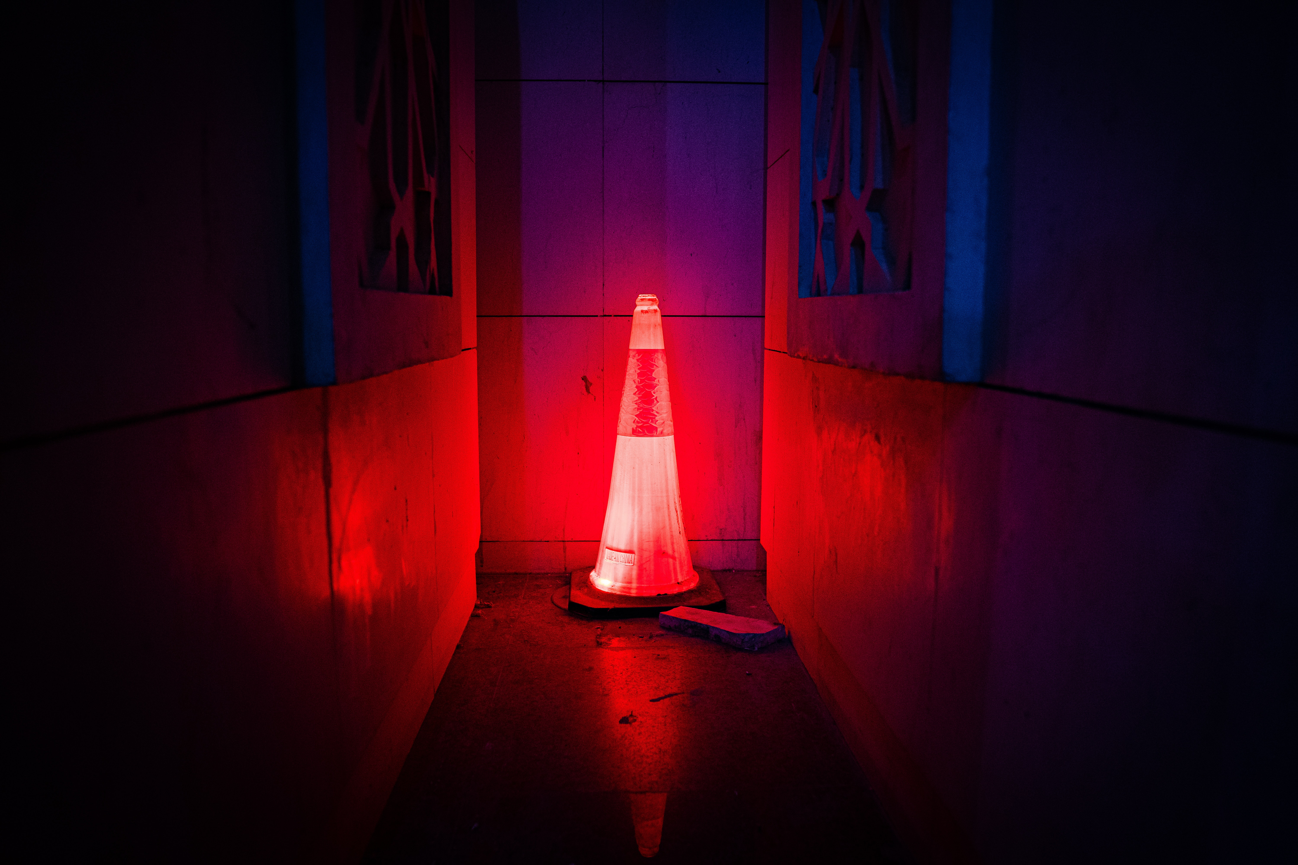



Solution 1
We want to design a system which can tell the users that they didn’t turn on the mic in a effective way.
Red often gives us the impression of awareness , so we use flashing red light to remind people to turn the mic on.

Slide 4

Problem 2 – absent-minded
Feeling bored because you have to sit at the computer desk? We thought this is another common issue that people might face when working at home for a period.

Slide 5
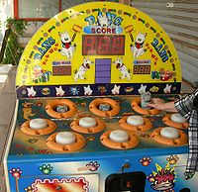
Solution 2
We design a little game on keyboard which based on “whac-A-Mole” .
It is easy to play and gives you a refresher after finishing the game.

Slide 6


Problem 3 – atmosphere
In some situations, we might want to use tools that can make sounds for whether interpret your ideas or build up the atmosphere. For instance, if someone tells a joke but nobody laugh, and he/she might be embarrassed. What should we do?

Slide 7
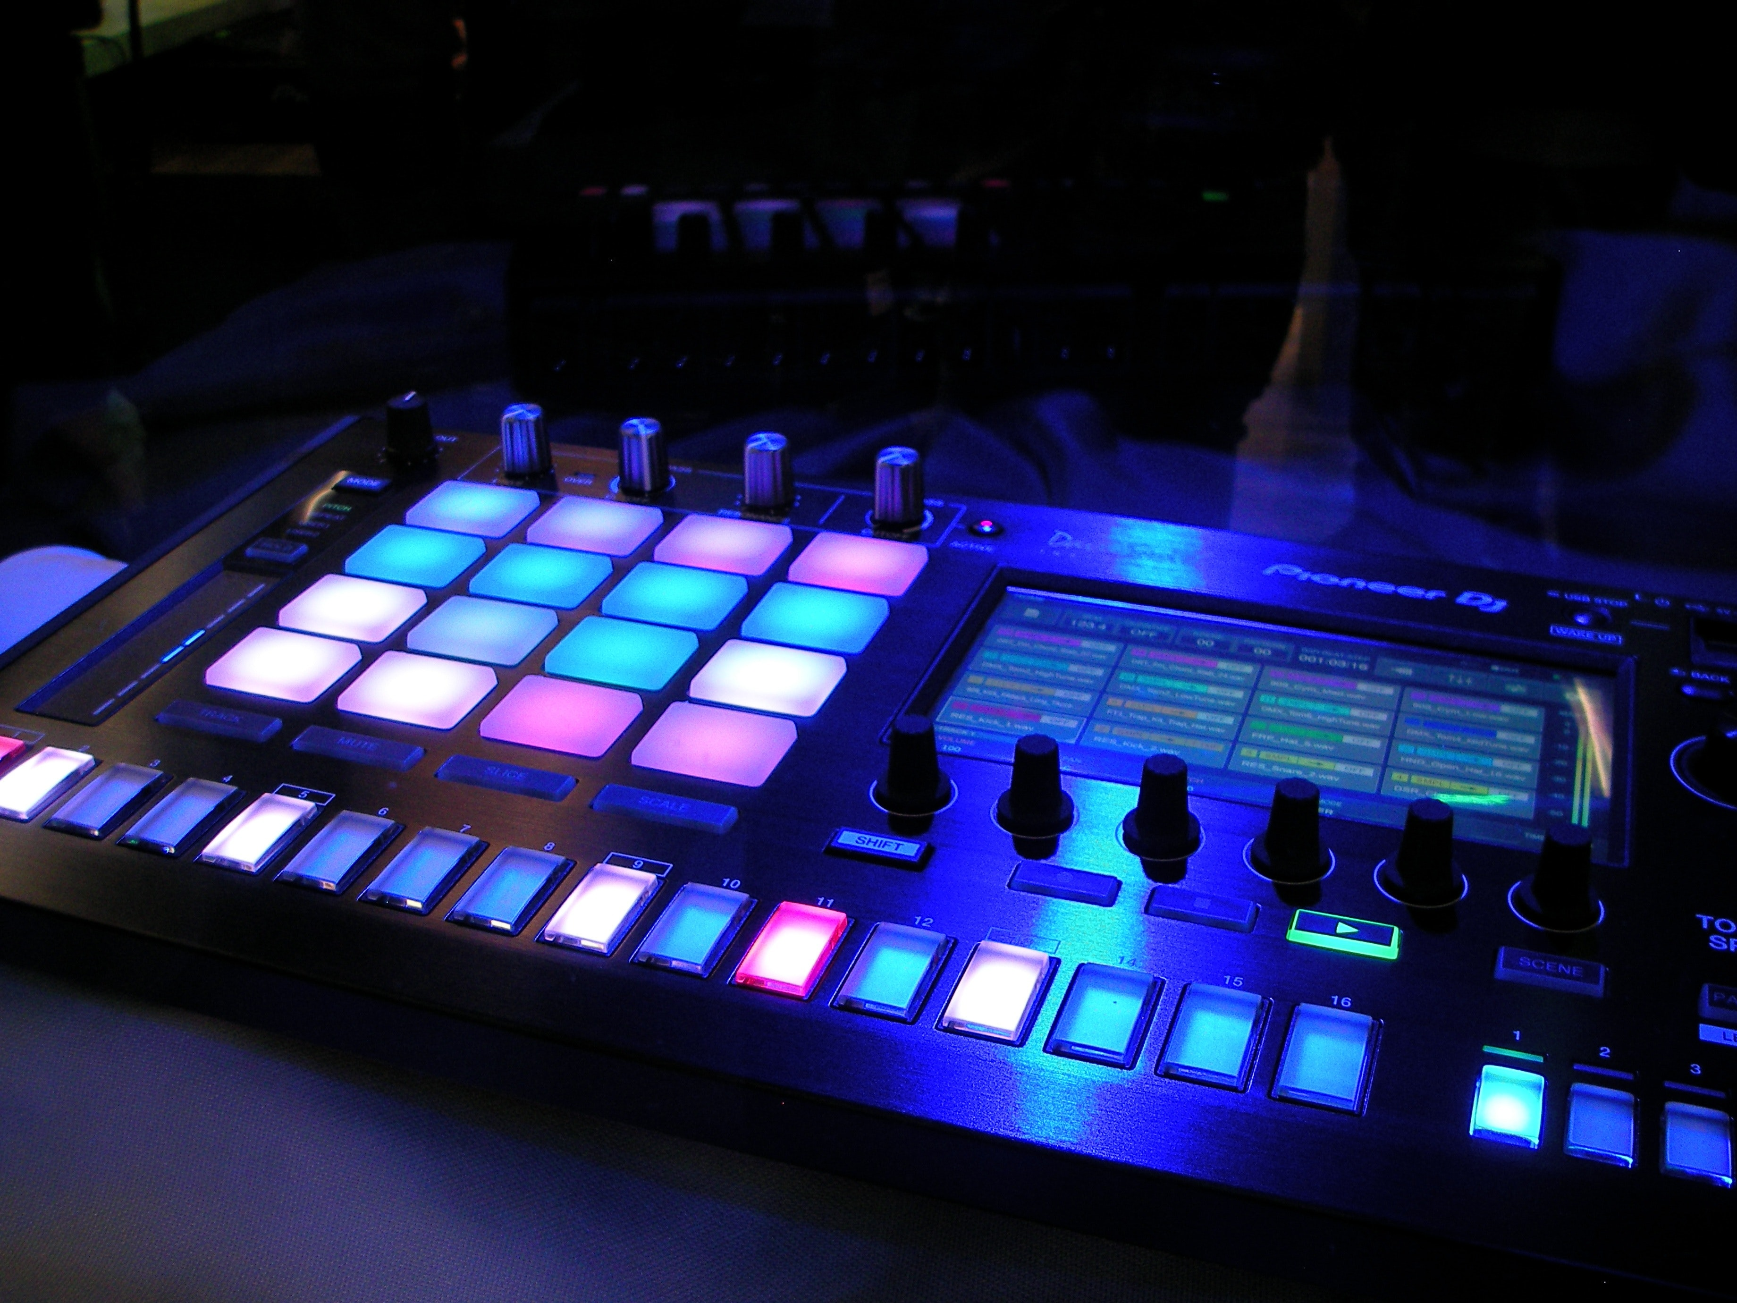
Solution 3
We want to add a mode in Logi Craft . When we change its mode, it will turn to a launchpad builded with various sounds including laughter. Thus, we can eliminate the embarrassment.

Slide 8
Other problems…

Slide 9

Thanks for your listening !

